Slide 1
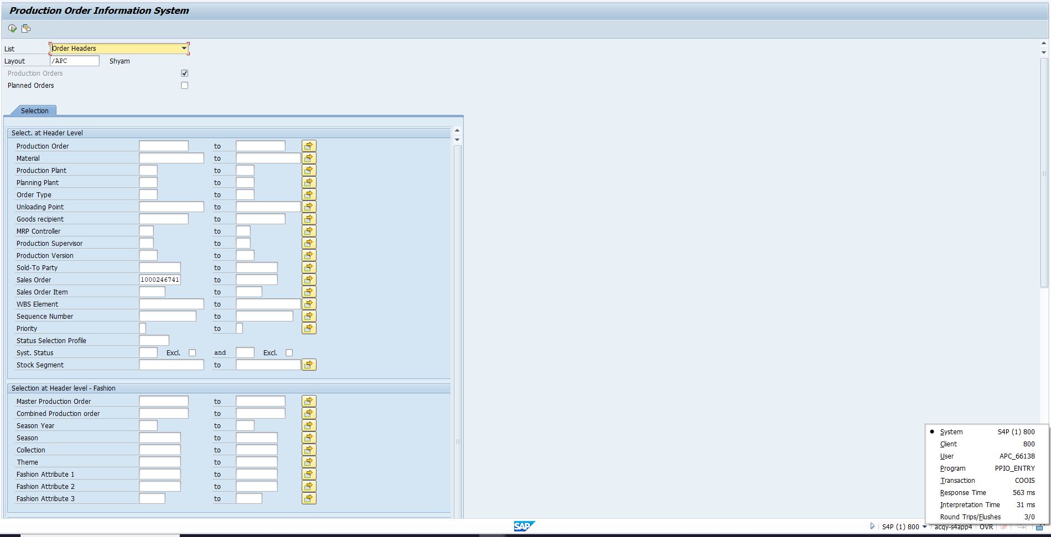
For getting the Master PO based on the Sales Order, use SAP COOIS – T-code.
Enter the SO in the first box.
Click on the icons present in the second box.
2
1

Slide 2
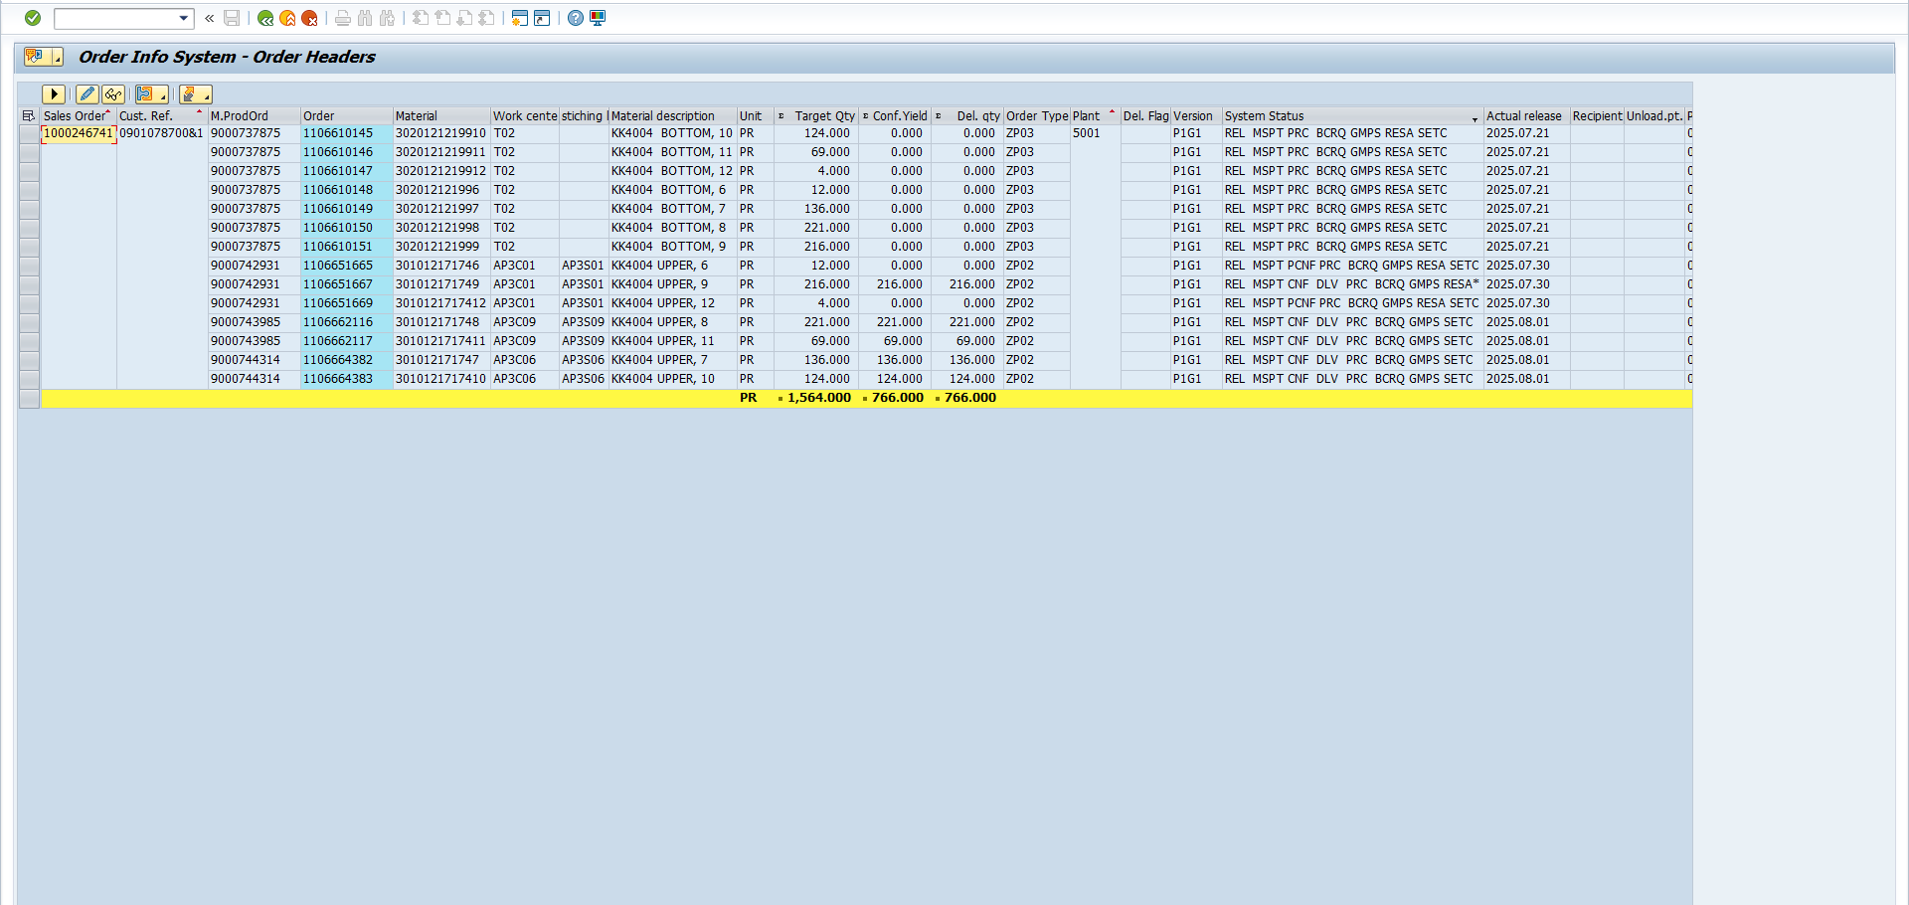
After click on Execution button , you can observe the master pos for upper and bottom materials.

Slide 3
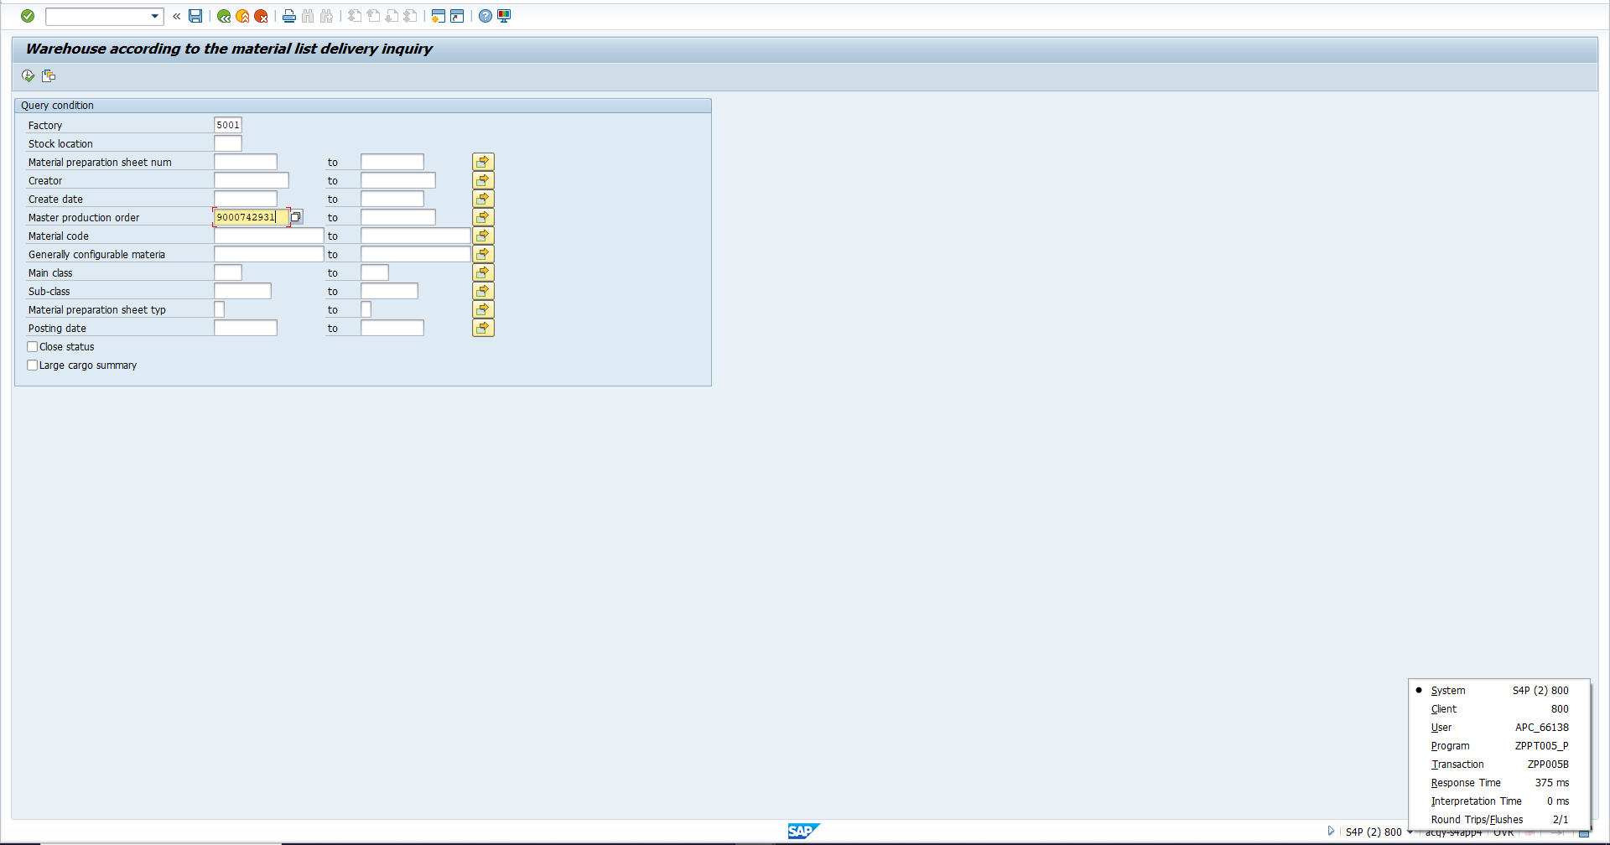
Check Fetching is generated on not for the master po using ZPP005B Tcode
Enter Factory in first box and enter Master production order in second box after click on execute button ( box 3 )
3
1
2

Slide 4
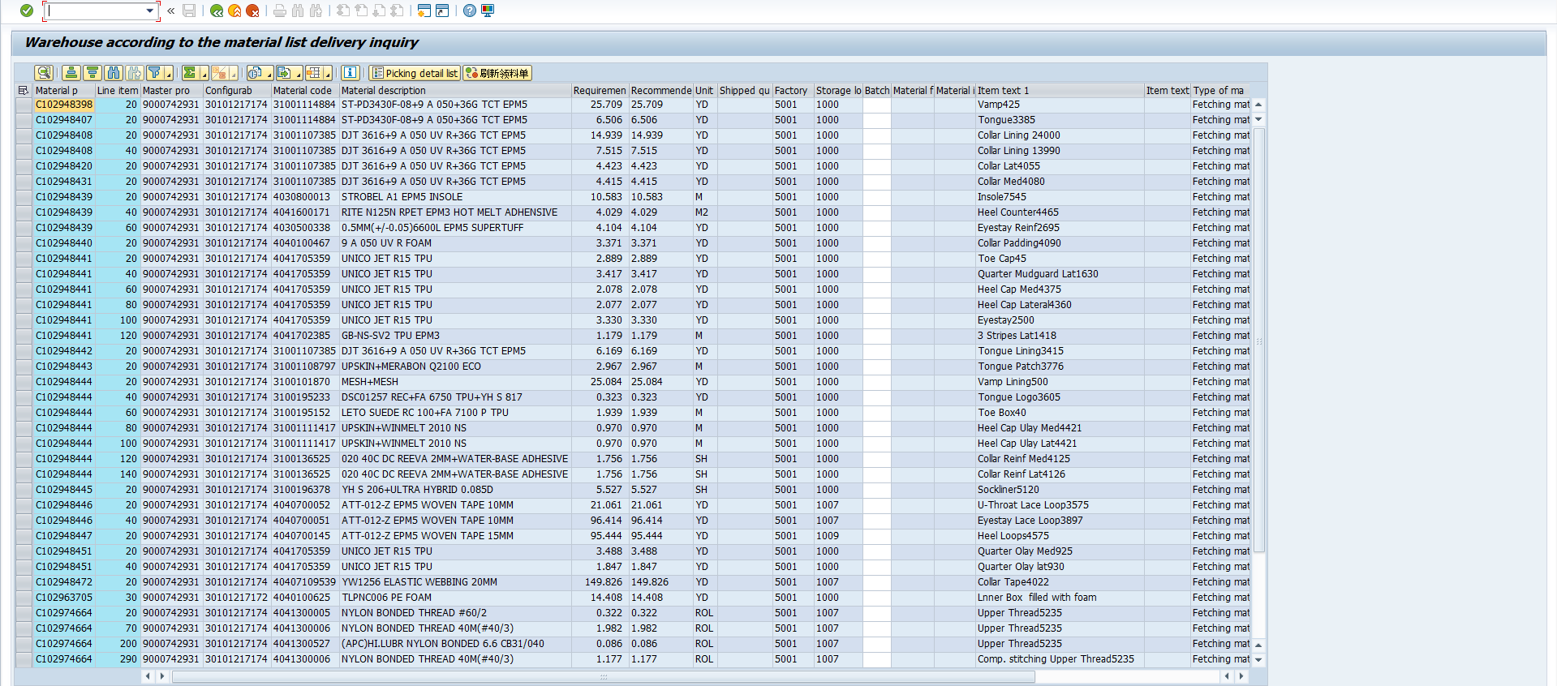
Now Your able to check fetching is generated or not for the master production order.

Slide 5
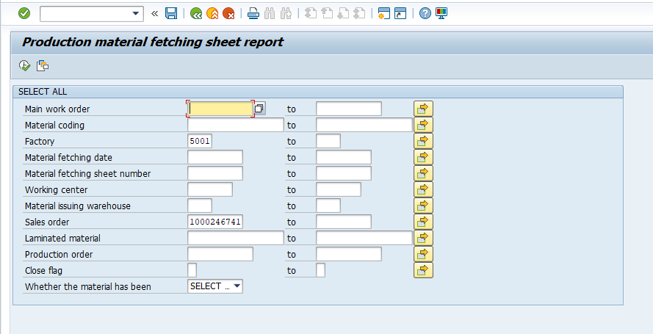
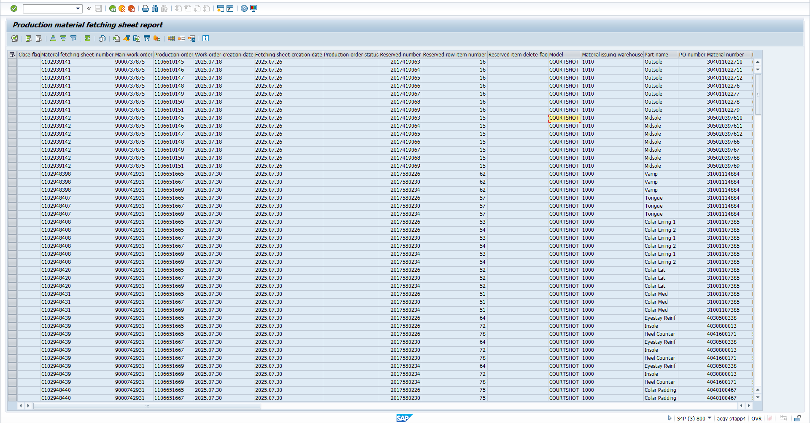
Otherwise use ZMM113 Tcode for check fetching recommended qty and issue qty and unissued qty for a sales order .

